Slide 1

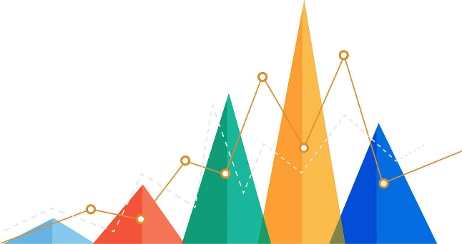
Understanding the Mode in Statistics
The mode is a fundamental concept in statistics, offering insights into the most frequent values within a dataset.

Slide 2
What is the Mode?
The mode represents the value that appears most often in a dataset.
Definition
The mode is the value that occurs with the highest frequency in a distribution. It helps identify the most common or typical data point within a dataset.
Example
In the dataset {2, 4, 4, 5, 7, 4}, the mode is 4 because it appears three times, more than any other value.

Slide 3
Example Dataset
Let's consider a dataset showing the number of cars sold by a dealership each day for a week: {10, 15, 12, 15, 18, 15, 12}.
Dataset
Mode
{10, 15, 12, 15, 18, 15, 12}
The mode is 15, as it appears three times, making it the most frequent value.

Slide 4


Real-World Use of Mode
The mode finds applications in various fields, including business and marketing.
1
Business
2
Marketing
3
Surveys
Businesses use mode to identify the most popular product or service, informing inventory management and marketing strategies.
Marketers utilize mode to understand consumer preferences and tailor their campaigns to cater to the most common needs and interests.
Survey data analysis uses mode to identify the most frequent responses, providing valuable insights into public opinion and trends.

Slide 5




Where have you encountered the mode in your everyday life? Share your examples in the comments below!
Question
Share
Do you remember a time when the mode helped you understand a trend or pattern in data?
Share your experiences with mode in the comments! We'd love to hear your examples.

Slide 6

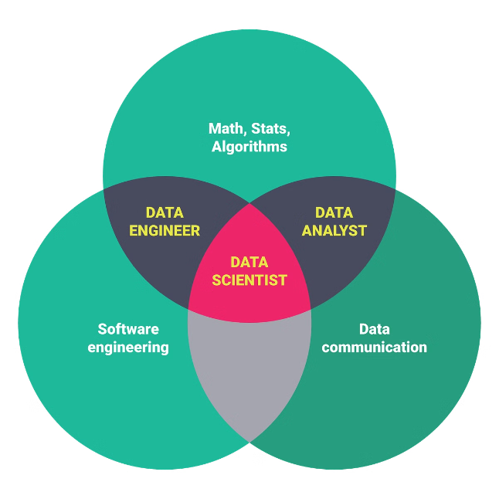
Closing
The mode is a valuable statistical tool for understanding the most frequent occurrences within a dataset.
Summary
Applications
The mode represents the most frequent value in a dataset, providing insights into the most common or typical data point.
Mode finds applications in various fields, from business to marketing to survey analysis.

Slide 7





Follow for More Insights
Stay tuned for more statistical concepts and data analysis insights.
Subscribe
Subscribe to our channel to receive notifications about new videos and resources.
Share
Share this video with your friends and colleagues to help spread the knowledge of statistics.
Engage
Leave a comment below with your thoughts and questions about the mode.

Slide 8


Thank You
Thank you for watching! We hope this video has helped you understand the mode in statistics.

